Slide 1
Data Science Math- Applied Calculus

Slide 2
Discussion
Content of the Data Science Math Section
Office Hours
Homework Discussion
Applied Calculus
Functions / Limits
Derivatives
Integrals / Fundamental Theorem of Calculus
Functions of Two Variables

Slide 3
Functions in R-And Non-Functions
par(mfrow=c(2,2)) #set up graphs in 2x2 matrix
fx=function(x){3*(x+1)*(x-4)*(x+5)}
s=seq(-10,10,by=.01)
a=fx(s)
plot(a~s,type="l")
fy=function(y){y^2}
a=fy(s)
plot(a~s,type="l")
fz=function(z){log(z)}
s=seq(0,10,by=.01)
a=fz(s)
plot(a~s,type="l")
fqplus=function(qplus){sqrt(qplus)}
fqneg=function(qneg){-sqrt(qneg)}
s=seq(0,10,by=.01)
a=fqplus(s)
b=fqneg(s)
fin=c(a,b)
s2=c(s,s)
plot(fin~s2,type="p")

Slide 4
Evaluating Limits Numerically in R
install.packages("rootSolve") #add-in in Excel, library in C
library(rootSolve)
fx=function(x){3*(x+1)*(x-4)*(x+5)}
s=seq(-10,10,by=.01)
a=fx(s)
plot(a~s,type="l")
#find the y intercept
yint=fx(0)
#find the x intercept
xint=uniroot(fx,c(-100,100))
points(xint$root,yint,col="red",pch=21)
xint$root
yint

Slide 5
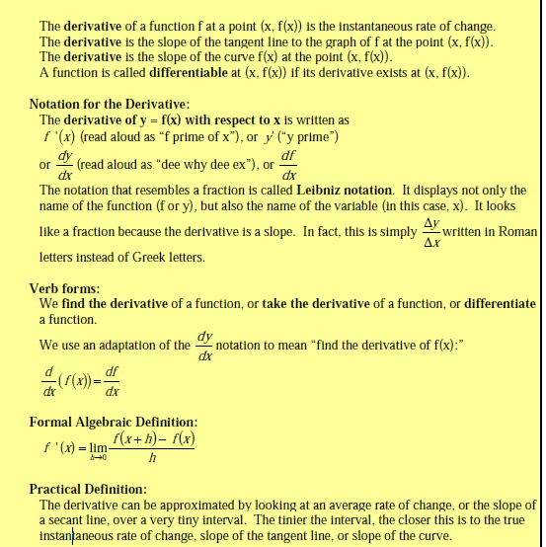
Derivatives

Slide 6
Symbolic and Numeric Derivatives in R
#take the symbolic derivative of log(x)
install.packages("Deriv")
library(deriv) #references add-in
myf1=function(x)sin(x)
Deriv(myf1)
#take the symbolic derivative of 1/x
myf2=function(x)1/x
ans=Deriv(myf2)
ans
#evaluate the derivative of 1/x at x=3
ans(3)

Slide 7
Symbolic Derivatives: Rules
#Power Rule, px^(p-1)
myf1=function(x)x**n
Deriv(myf1)
#Addition rule, dx(f)+dx(g)
myf2=function(x)3*x+(3*x^2+1)
Deriv(myf2)
#Exponential Function, Identity
myf3=function(x)exp(x)
Deriv(myf3)
#Logarithm Function, 1/x
myf4=function(x)log(x)
Deriv(myf4)
#Product Rule, f'g+g'f
myf5=function(x)3*x*(3*x^2+1)
Deriv(myf5)
Quotient rule f/g, (f'g-g'f)/g^2
myf6=function(x)3*x/(3*x^2+1)
Deriv(myf6)
#Chain rule, f'u*g'x
myf7=function(x)3*(x^2+2)^2
Deriv(myf7)

Slide 8
Max and Min of Functions
1st and 2d Derivatives
Numerically
#f(x) = x^3 – 3*x^2 – 9*x + 5 for –2 ≤ x ≤ 6
library(mosaic)
library(Deriv)
library(rootSolve)
fx=function(x){x^3-3*x^2-9*x + 5}
s=seq(-2,4,by=.1)
a=fx(s)
data=cbind(s,a)
plot(data, type="l", main="Solve for Max between -2 and 4")
min(a) #-22
max(a) #10
first=Deriv(fx)
a=uniroot.all(first,c(-2,4))
a #-1 and 3

Slide 9
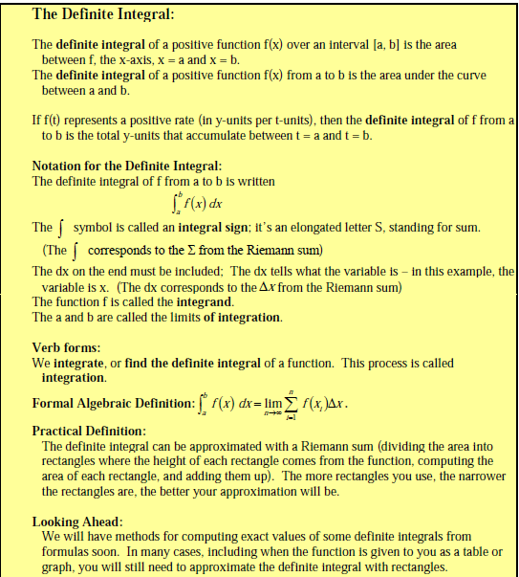
Integration

Slide 10
Definite Integrals
#R Base Function, integrate
fx=function(x)-2
integrate(Vectorize(fx),1,4) #Some functions puke w/o vectorize
fx=function(x)exp(x^2+x)
integrate(fx,1,2)

Slide 11
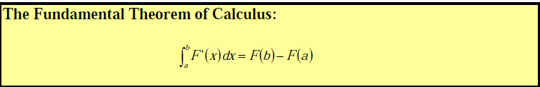
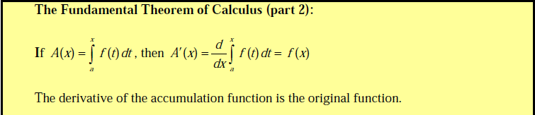
Fundamental Theorem

Slide 12
Indefinite Integrals
#Constant Multiple Rule, int(k*f)=k*int(f)+C
library(mosaic)
antiD(5~x)
#Sum Rule (separable)
antiD(x-2+x^2~x)
#Power Rule, x^n -> (x^(n+1)/(n+1)
antiD(x^3~x)
#Exp(x)=>exp(x)+C
antiD(exp(x)~x)
#1/x=>ln|x|+C
antiD(1/x~x)
Substitution
u=f(x)
x=f^-1(u)
du=f'(x)dx
dx=du/f'(x)
By parts
int(udv)=uv-int(vdu)

Slide 13
Two (and More) Variable Problems
library(cubature)
fxyz=function(x) {(x[1]-2)^2+(x[2]+3)^2+(x[3]-4)^2-9}
adaptIntegrate(fxyz,lower=c(-10,-10,-10),upper=c(10,10,10))

Slide 14
Review of Calculus-Based Probability Problems Basic Linear Algebra

Slide 15
Matrices
What is a matrix?
Matrix Operations
Identity Matrix
Inverse Matrix
Row Operations

Slide 16
What is a Matrix?
A=matrix(c("a11","a21","a12","a22"),2,2)

Slide 17
More Matrix Examples
B=matrix(c(1,5,-2,3,9,7,-4,0,6),3,3)
C=matrix(c(-4,0,5,3,0,-2),2,3)

Slide 18
Adding Matrices
D=matrix(c(1,3,-2,5,0,4),2,3)
E=matrix(c(4,-2,3,2,-1,-4),2,3)
D+E

Slide 19
Subtracting Matrices
F=matrix(c(5,9,7,-6,10,-2),3,2)
G=matrix(c(5,-3,6,6,11,-1),3,2)
F-G

Slide 20
Properties of Matrix Addition
Commutative Property
A + B = B + A (Order does not matter)
Associative Property
(A + B) + C = A + (B + C) (Grouping does not matter)
Additive Identity
A + 0 = 0 + A = A (When you add to 0 then the matrix keeps its identity)
Additive Inverse
A + (-A) = -A + A = 0 (If you add the opposite, then you get 0.)
F+G
G+F
(C+D)+E
C+(D+E)
B+0 #R knows that this is a matrix of zeros
0+B
B+-B
-B+B

Slide 21
Scalar Multiplication
Remember to distribute the scalar to each element in the matrix.
H=matrix(c(-3,0,6,-9),2,2)
l=2
l*H

Slide 22
Example:
J=matrix(c(5,6,0,-2),2,2)
K=matrix(c(0,3,-1,5),2,2)
m=2
n=-3
m*J+n*K

Slide 23
Multiplying Matrices
L=matrix(c(1,0,2,4),2,2)
M=matrix(c(5,-2),2,1)
L%*%M
#what is M%*%L…???
M%*%L
#What about t(M)%*%L
t(M)%*%L
Rows A * Columns of B, inner dimensions must match!!
2 x 2 x 2 x 1

Slide 24
Multiplying Matrices

Slide 25
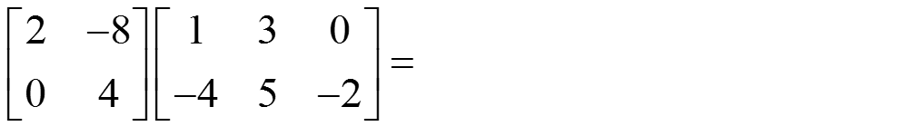
Multiplying Matrices Ex 2
L%*%M
N=matrix(c(2,0,-8,4),2,2)
O=matrix(c(1,-4,3,5,0,-2),2,3)
N%*%O

Slide 26
NOTE: Left and Right Multiplying Matrices of Equal Size
IN general, left multiplication and right multiplication will produce different results!
A=matrix(c(2,2,3,4),2,2)
B=matrix(c(3,1,1,-1),2,2)
A%*%B
B%*%A

Slide 27
Identity Matrix

Slide 28
Finding the multiplicative Inverse of a 2x2 Matrix

Slide 29
2x2 Inverse Example
A=matrix(c(5,-3,2,0),2,2)
solve(A)

Slide 30
Steps to finding the multiplicative inverse
Form the augmented matrix [A│I_{n}]
Perform row operations on it to obtain a matrix of the form [I_{n}│B].
Matrix B is the inverse matrix.
Verify the results by multiplying AB to see if you get I_{n}

Slide 31
Matrix Row Operations
Two rows may be interchanged
The elements in any row may be multiplied by a nonzero number
The elements in any row may be multiplied by a nonzero number, and these products may be added to the corresponding elements in any other row.

Slide 32
Finding the inverse example:

Slide 33
Finding the inverse example

Slide 34
Finding the inverse example

Slide 35
Finding the inverse example

Slide 36
Finding the inverse example

Slide 37
Solving Systems of Equations Ax=b when A is Square
Ax=b
A⁻¹Ax=A⁻¹b
x=A⁻¹b
A=matrix(c(2,2,3,4),2,2)
b=c(2,2) #column
solve(A)%*%b

